Slide 1


Slide 2

PRESENTATION BY
Gokulnath.P.R
Sugavaneshwaran.S
Bharathkuamr.S.M
Sivakumar.P
Harrish.M

Slide 3

Objective:
The main objective of this project was to conduct a comprehensive analysis of [insert project focus] using big data techniques, in order to derive valuable insights for [insert specific purpose].

Slide 4

The project followed a design thinking process that involved the following stages:
Design Thinking Process:
1. Empathize 2. Define 3. Ideate 4. Prototype 5. Test

Slide 5

1. Empathize: Understanding the requirements and constraints of the project stakeholders. 2. Define: Clearly defining the scope, objectives, and constraints of the analysis project.

Slide 6

3. Ideate: Brainstorming various data analysis techniques and potential methodologies to be employed. 4. Prototype: Creating initial models and trial analyses to validate the approach.

Slide 7

5. Test: Evaluating the effectiveness of the analysis methodologies and refining the approach.

Slide 8

Development Phases: The development of the project took place in the following stages:
1. Planning phase
2. Development phase
3. Testing phase
4. Deployment phase

Slide 9

Define project scope, objectives, and deliverables.
1. Planning phase

Slide 10
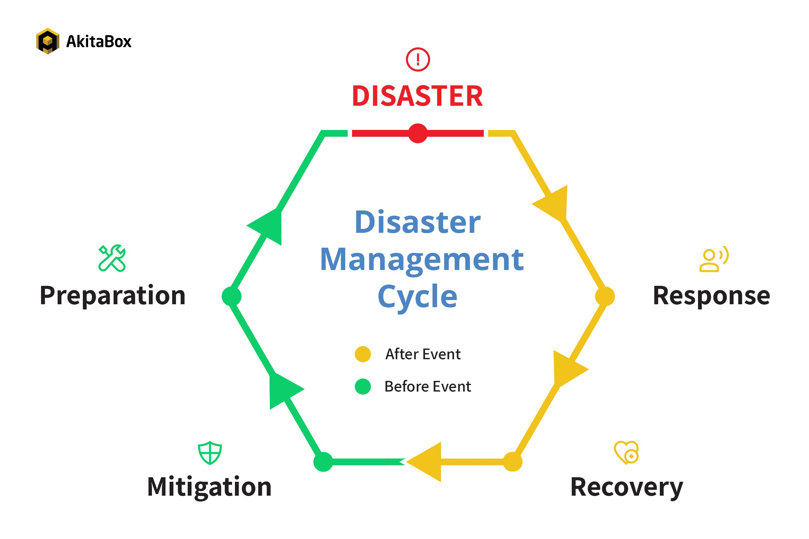
1. Planning phase

Slide 11
Create a detailed timeline, assign tasks, and start coding the project.
2. Development phase

Slide 12
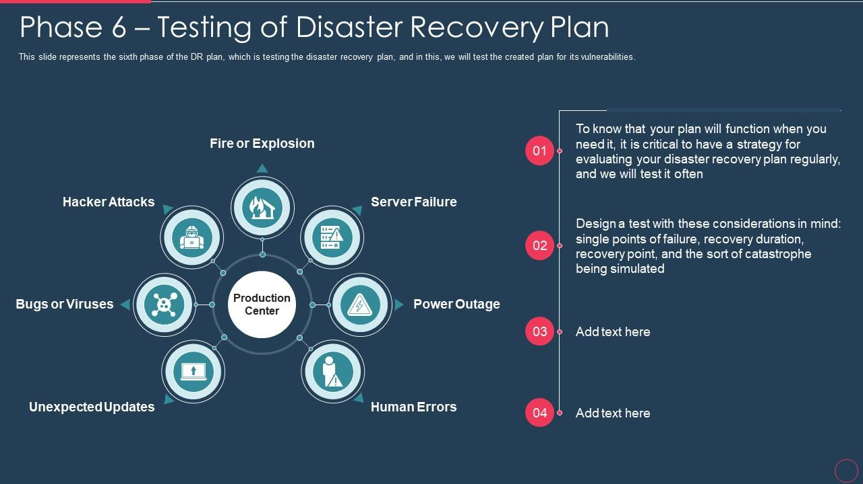
2. Development phase

Slide 13

3.Testing phase
- Conduct comprehensive testing to ensure the project functions correctly and meets the requirements.

Slide 14
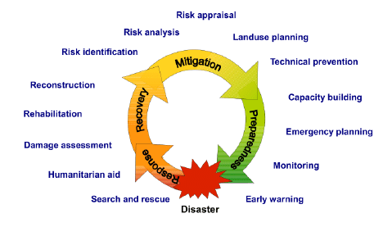
3.Testing phase

Slide 15

Launch the project and monitor its performance.
2. Development phase

Slide 16
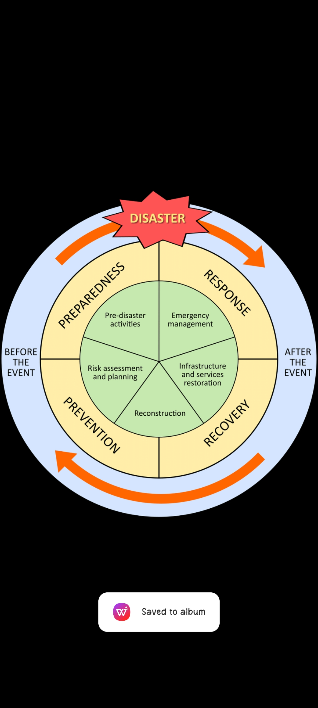
4. Deployment phase

Slide 17
Website Structure
Home Page:
Introduction to the blog, featured posts, and navigation.
Blog Categories:
Different sections or categories for specific topics.
Individual Blog Posts:
Detailed articles with text, images, and potentially multimedia elements.
About Page:
Information about the author or team behind the blog.
Contact Page:
A form or contact details for user inquiries.
Search and Navigation:
Search bar, category filters, and intuitive navigation menus.

Slide 18
from flask import Flask, render_template
app = Flask(__name__)
# Dummy data for blog posts
posts = [
{'id': 1, 'title': 'First Post', 'content': 'This is my first blog post.'},
{'id': 2, 'title': 'Second Post', 'content': 'Another blog post for testing.'},
]
@app.route('/')
def home():
return render_template('home.html', posts=posts)
@app.route('/post/<int:id>')
def post(id):
post = next((p for p in posts if p['id'] == id), None)
if post:
return render_template('post.html', post=post)
else:
return "Post not found.", 404
if __name__ == '__main__':
app.run(debug=True)

Slide 19
Output
python app.py

Slide 20
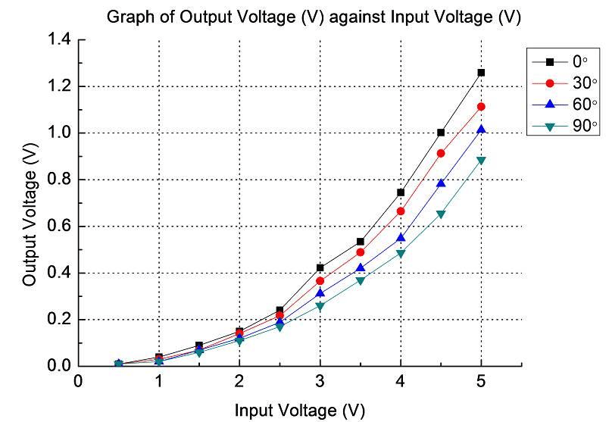

Slide 21
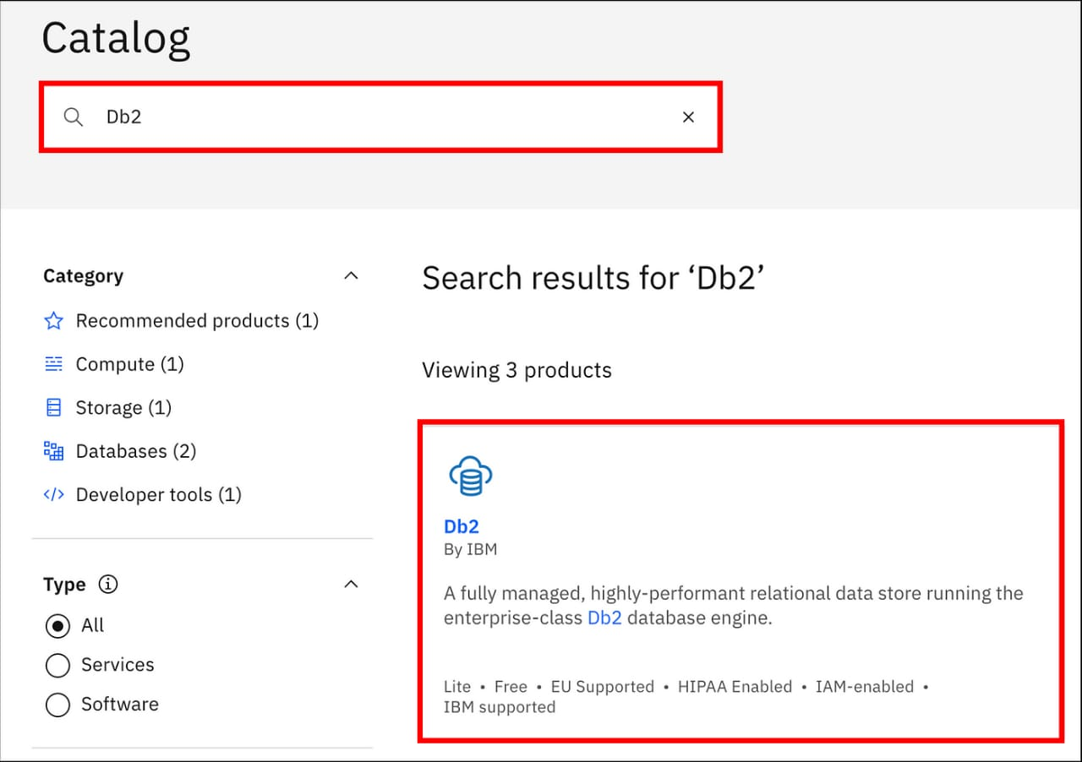

Slide 22
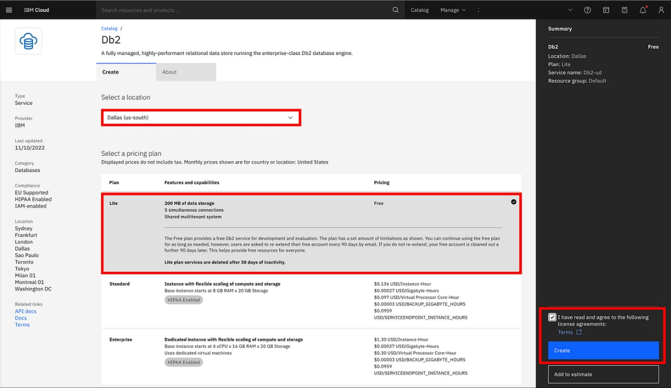

Slide 23
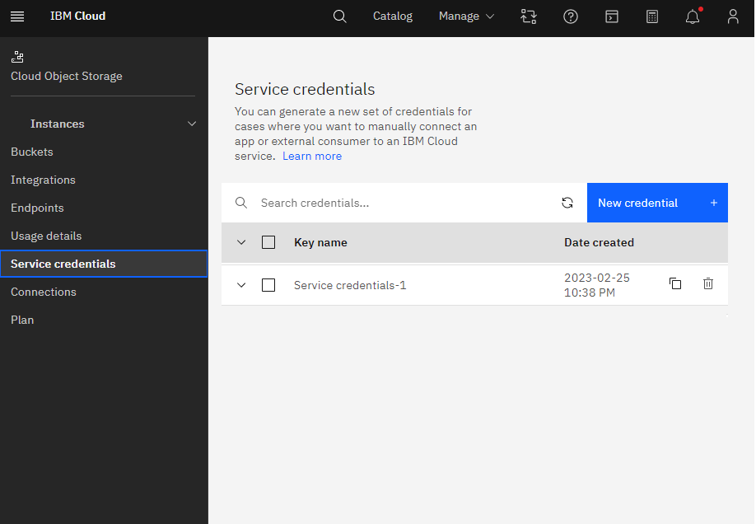

Slide 24


